Slide 1

Analysis of entity encoding techniques, design and implementation of a multithreaded compile-time Entity-Component-System C++14 library
Università degli Studi di Messina
Dipartimento di Scienze Matematiche e Informatiche,
Scienze Fisiche e Scienze della Terra
Corso di Laurea Triennale in Informatica
Laureando:
Vittorio Romeo
Relatore:
Prof. Giacomo Fiumara
Anno Accademico 2015/2016

Slide 2
Introduction
Successful development of complex real-time applications and games requires a flexible and efficient entity management system
It’s critical to find an elegant way to compose objects in order to:
Prevent code repetition (DRY principle)
Improve modularity, performance and flexibility
The Entity-Component-System architectural pattern was designed to achieve the aforementioned benefits, by separating data from logic
What is the Entity-Component-System pattern?
How can it be implemented without sacrificing performance, safety and an high level of abstraction?
Notes:
What I am claiming:
ECS is a beneficial pattern in terms of performance, code quality and flexibility.
Implementing ECS does not require to sacrifice abstractions and safety, thanks to C++’s cost free abstractions.

Slide 3
Outline
Entity encoding techniques
Object-oriented inheritance
Object-oriented composition
Data-oriented composition
Overview and implementation of ECST
Design and core values
Features/limitations
Example case study: particle simulation
Notes:
1st part objective: show the superiority of ECS for complex applications/games.
2nd part objective: show how a powerful library can be implemented without sacrificing abstraction, ease of use and performance.
3rd part objective: show performance benefits of ECST and multithreading, show syntax transparency.

Slide 4
Entity encoding techniques
Concepts, benefits and drawbacks of entity encoding architectural patterns

Slide 5
What is an entity?
Something tied to a concept
Has related data and/or logic
Many instances of the same entity type
Specific instances must be trackable
Can be accessed and modified
Creation, destruction, mutation, reading
Examples:
Game objects: player, bullet, car
GUI widgets: window, textbox, button
Notes:
No real formal definition
More examples: VFX/3D software primitives, client states in a server, etc

Slide 6

Encoding entities – OOP inheritance
An entity type is a polymorphic class
Data is stored inside the class
Logic is handled using runtime polymorphism
Very easy to implement
Cache-unfriendly
Runtime overhead
Lack of flexibility
Notes:
Implementing entities = «encoding».
Arrow means: «inherits from».
Overhead both in terms of speed and memory.
Vtables.
Virtual calls.
Dynamic allocation.

Slide 7

Encoding entities – OOP composition
An entity is an aggregate of components
Components store data and have logic
Logic is handled using runtime polymorphism
Easy to implement
More flexible
Cache-unfriendly
Runtime overhead
Notes:
Arrow means: «is part of» or «composes».
Components can communicate via references or event buses.

Slide 8
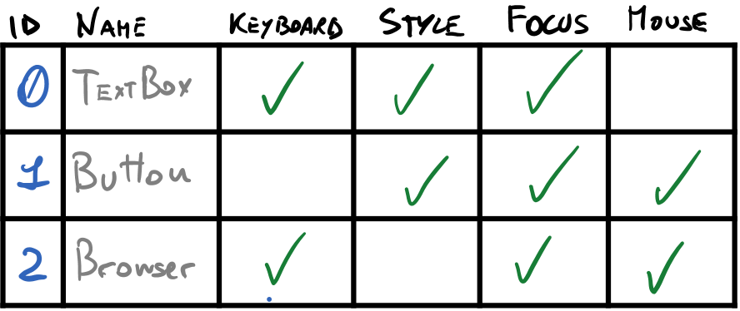
Encoding entities – DOD composition
An entity is a numerical ID
Components only store data (logicless)
Logic is handled using systems
Potentially cache-friendly
Minimal runtime overhead
Great flexibility
Hard to implement
Notes:
System: performs logic on all entities having a specific set of components
Best approach because:
Data can be stored contiguously, thus achieving cache-friendliness
No polymorphism, thus no memory/runtime overhead
Components can be mixed and matched, thus achieving flexibility
Data is separated, thus allowing easy serialization, networking and separation of concerns

Slide 9
Overview and implementation of ECST
Design, features, limitations and examples

Slide 10
Core values and concepts
«Compile-time» ECS
Customizable settings/policy-based design
Transparent user syntax
Multithreading support
Avoid explicit locking
«Dataflow» programming
Modern «type-value encoding» metaprogramming
Clean, modern and safe C++14
Notes:
Explain every point.
Multithreading will be analyzed in the following slide.
Single-machine library.

Slide 11
Multithreading support
Enabled by default, customizable and can be optionally disabled
Two levels of parallelism:
Outer: independent system chains can run in separate parallel tasks
Inner: system logic can be independently performed on entity subsets in separate tasks
Notes:
Implicit DAG.
Black circles: systems.
Blue circles: subtasks.
Every system or subtask can produce output.
The successor system can then iterate or fold over the previous outputs.
Dependencies are ensured statically.
Arrows: dependencies.

Slide 12
Challenges
Efficient management of entity IDs
Exploiting compile-time knowledge to increase performance and safety
Executing systems respecting dependencies between them and using parallelism when possible
Processing entities subsets of the same system in different threads
Dealing with entity/component addition/removal during system execution
Providing a clean and safe interface to the user
Notes:
Entity ID management: next slide
Compile-time knowledge: static control flow
Respecting dependencies: implicit DAG
Subtasks: synchronization via counters, avoid explicit locking, thread pool (next slide)
Critical operations: deferred functions
Interface: syntax transparency

Slide 13
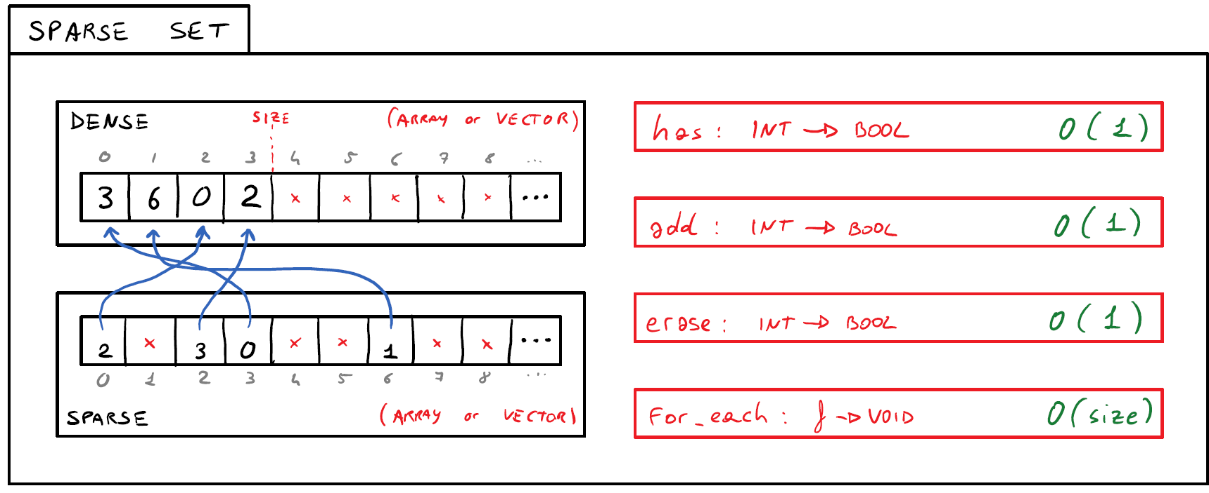
Sparse Integer Sets
Notes:
Extremely efficient for entity ID management.
Does not support efficient bitset-like bit operations.

Slide 14
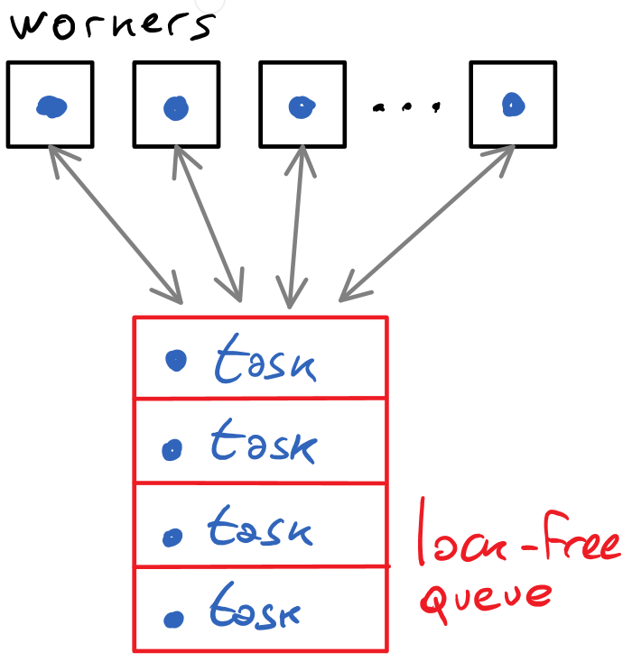
Multithreading details
Avoid busy waiting, use condition variables
Use thread pooling with a fast lock-free concurrent queue

Slide 15
Example case study: particle simulation
Description, screenshots and benchmarks

Slide 16
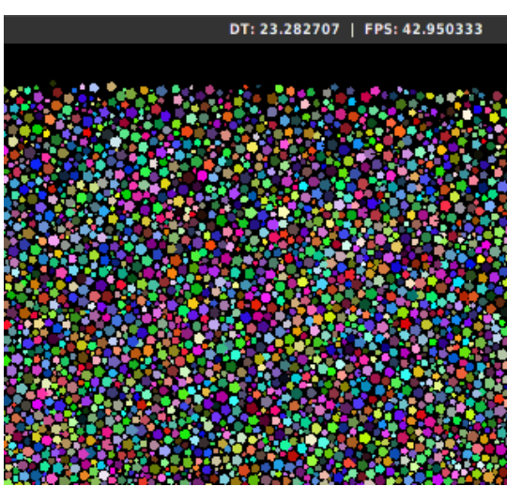
Overview
Huge number of particles
Circle versus circle collisions
Completely elastic collisions
2D grid broad spatial partitioning
Particles slowly decay
6 component types
9 system types

Slide 17
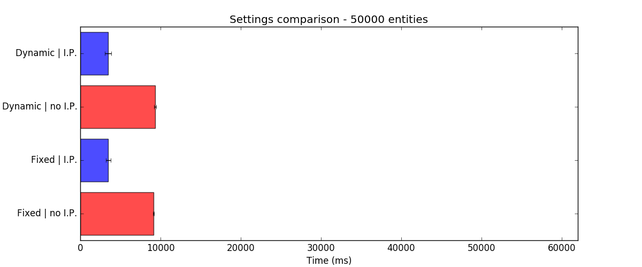
Results – 50000 entities

Slide 18
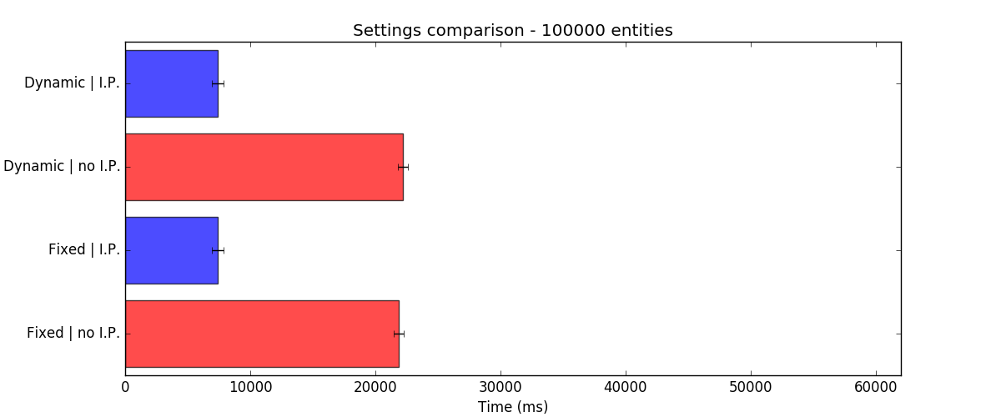
Results – 100000 entities

Slide 19
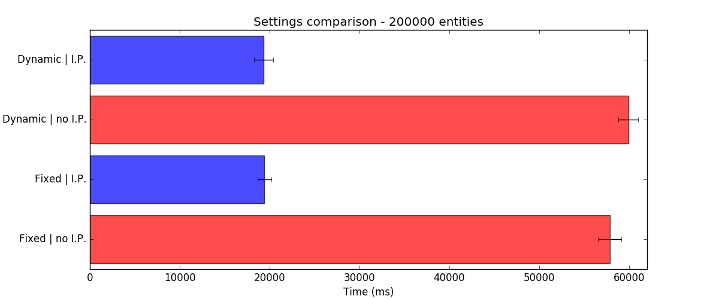
Results – 200000 entities

Slide 20
Suggested readings
Open-source repositories:
ECST library: https://github.com/SuperV1234/ecst
Thesis PDF/sources: https://github.com/SuperV1234/bcs_thesis
C++Now 2016: https://github.com/SuperV1234/cppnow2016
Other work:
Personal website: http://vittorioromeo.info/
YouTube channel: https://www.youtube.com/user/SuperVictorius
Contacts:
vittorio.romeo@outlook.com

